Slide 1
“DISCREETLY OPEN”
Accelerate Group 4 Nodejs projecT
To confession openly yet discreetly, in style.
~“May the confessions be ever in your favour”~
Lea Ho
Christy Law
Wilson Lau
May the confessions be ever in your favour

Slide 2
“DISCREETLY OPEN”
Why DO it?
An online social platform for creating anonymous confessions, appealing to injustice, and giving constructive advice to the "criminals" and the "victims".
Would be an ideal place for seeking advice and encouragements because posts are made anonymously and inappropriate content will be filtered.
The main purpose X personal attack X public trial =>to come up with constructive solutions for problems and help each other in the society.
You don’t need a tree hole anymore!
Let’s share the sorrow and thoughts together!
Everyone could be an angel to the others.
You don’t need a tree hole anymore

Slide 3
“DISCREETLY OPEN”
Featured Features
1 Authentication
Register an account
Login
Logout
2 Create anonymous posts (image is optional) in the role of
A Victim" of the specific event (Appeal)
A Criminal" of the specific event (Confession)
3 Post sorting
4 Give advice to the owners of the posts
5 Access to all the posts “I” created
6 Access to all the advice(comments) “I” gave
You don’t need a tree hole anymore

Slide 4
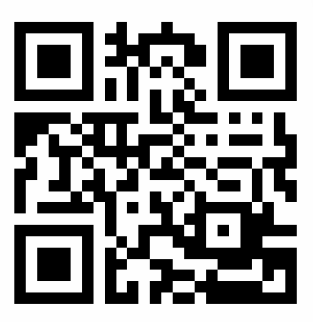
“DISCREETLY OPEN”
Let’s DO it!
Demonstration show time~
You don’t need a tree hole anymore

Slide 5
“DISCREETLY OPEN”
Design approach
1 Mind-map as a brainstorming tool 2 Wireframing and prototyping 3 Lucid-Chart as database designing tool
You don’t need a tree hole anymore

Slide 6
“DISCREETLY OPEN”
Built with
NodeJS Express Handlebars Postgresql and KnexJS CSS JavaScript With the use of: Bootstrap 4.1 (front-end framework) Github for collaboration
Production duration : around 3 weeks
You don’t need a tree hole anymore

Slide 7
“DISCREETLY OPEN”
Future Improvements
Vote Private Groups Update Post Delete Post Favouritelist Admin System
You don’t need a tree hole anymore

Slide 8
“DISCREETLY OPEN”
You don’t need a tree hole anymore.
Let’s share the sorrow and advice
To make the world better!
Thank you !
You don’t need a tree hole anymore

Slide 9
“DISCREETLY OPEN”
Any Questions?
You don’t need a tree hole anymore

